Slide 1
Exploring Play Store Application Trends.
CSE - A - 32

Slide 2
Table of Contents
3
Introduction
8
Queries
4
Objectives
9
Conclusion
5
Scope
6
Findings
7
Methodology

Slide 3

Intro
Play Store
Trends
The Google Play Store is one of the largest repositories of mobile applications, offering diverse apps catering to various user needs. By analyzing its data, businesses and developers can identify app trends, preferences, and key success factors for app development and optimization.
This project, "Exploring Play Store Application Trends," uses SQL queries to extract, filter, and analyze the data to derive meaningful insights about apps available on the platform.

Slide 4
Objectives
Play Store
Trends
To analyze app characteristics such as ratings, reviews, size, and pricing.
To identify trends in specific categories like ART_AND_DESIGN.
To provide actionable insights for developers and businesses.
Scope
This analysis focuses on:
Popular categories in the Play Store.
Characteristics that contribute to app success.
Comparison between free and paid apps.
Findings
User Engagement: Apps with high reviews generally correlate with higher ratings.
Free Apps Dominance: The majority of apps in ART_AND_DESIGN are free, making them more accessible to users.
Storage Efficiency: Smaller apps may appeal to users with limited device storage.

Slide 5

Methodology
Play Store
Trends
Data Extraction: SQL queries filter and retrieve relevant app data.
Data Analysis: Observations are made based on the output of queries.
Reporting: Insights are presented in the form of trends and recommendations.

Slide 6
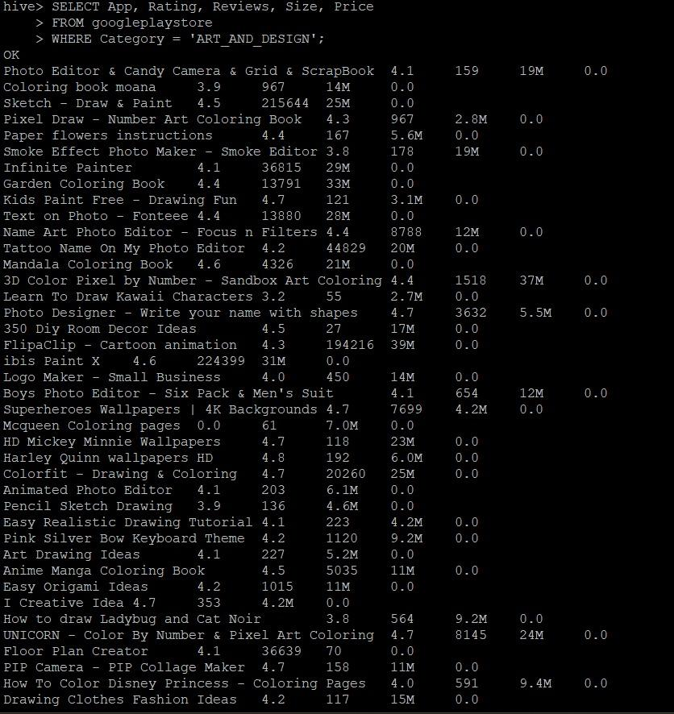
Hive Queries
Play Store
Trends
Query 1
1. create hive table :
CREATE TABLE googleplaystore (
App STRING,
Category STRING,
Rating FLOAT,
Reviews INT,
Size STRING,
Installs STRING,
Type STRING,
Price FLOAT,
Content_Rating STRING,
Genres STRING,
Last_Updated STRING,
Current_Ver STRING,
Android_Ver STRING
)
ROW FORMAT DELIMITED
FIELDS TERMINATED BY ','
STORED AS TEXTFILE;

Slide 7
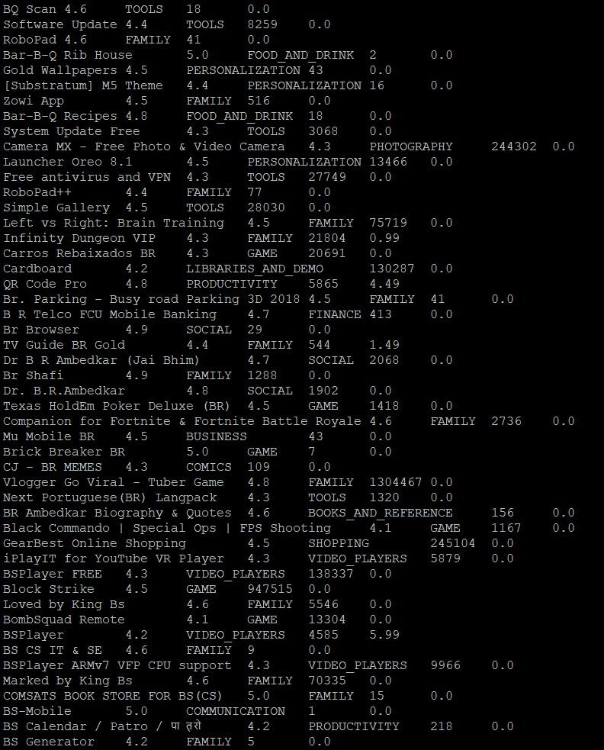
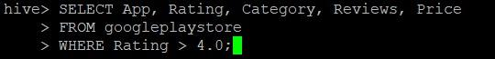
Play Store
Trends
Query 2
2. Load Data into Hive Table :
LOAD DATA LOCAL INPATH '/path/to/googleplaystore.csv' INTO TABLE googleplaystore;
ANALYSIS :
1. Get All Apps in a Specific Category:
SELECT App, Rating, Reviews, Size, Price
FROM googleplaystore
WHERE Category = 'ART_AND_DESIGN';
2. Get Apps with Rating Greater than 4 :
SELECT App, Rating, Category, Reviews, Price
FROM googleplaystore
WHERE Rating > 4.0;

Slide 8
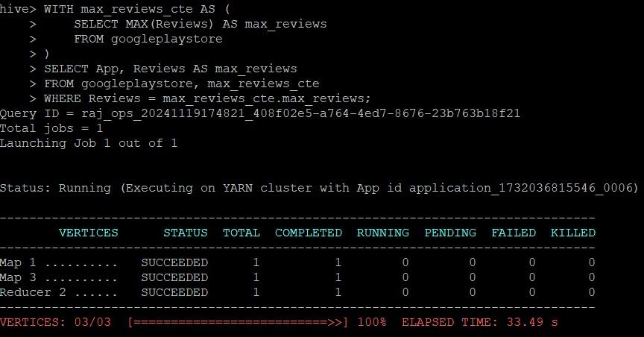
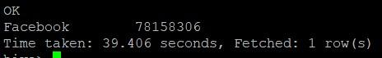
Play Store
Trends
Query 3
3. Find the App with the Highest Number of Reviews:
WITH max_reviews_cte AS (
SELECT MAX(Reviews) AS max_reviews
FROM googleplaystore
)
SELECT App, Reviews AS max_reviews
FROM googleplaystore, max_reviews_cte
WHERE Reviews = max_reviews_cte.max_reviews;D

Slide 9
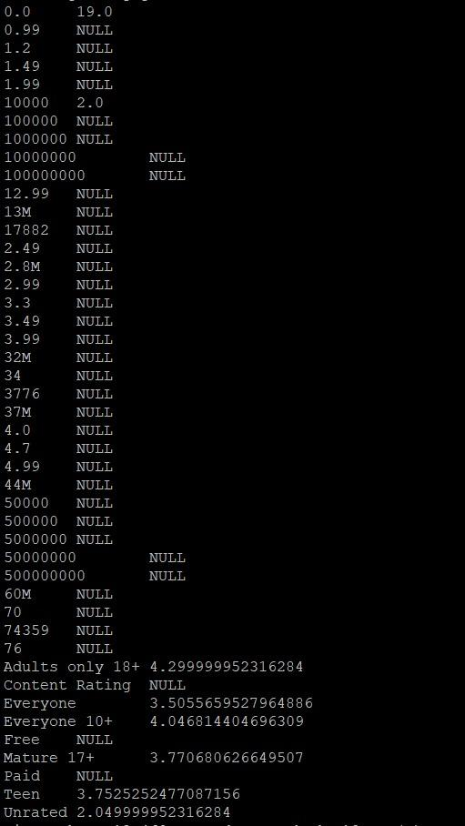
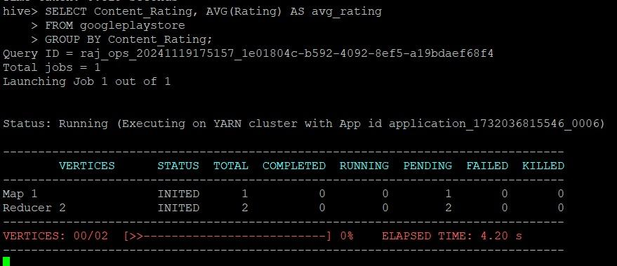
Play Store
Trends
Query 4
4. Calculate the Average Rating by Content Rating:
SELECT Content_Rating, AVG(Rating) AS avg_rating
FROM googleplaystore
GROUP BY Content_Rating;

Slide 10
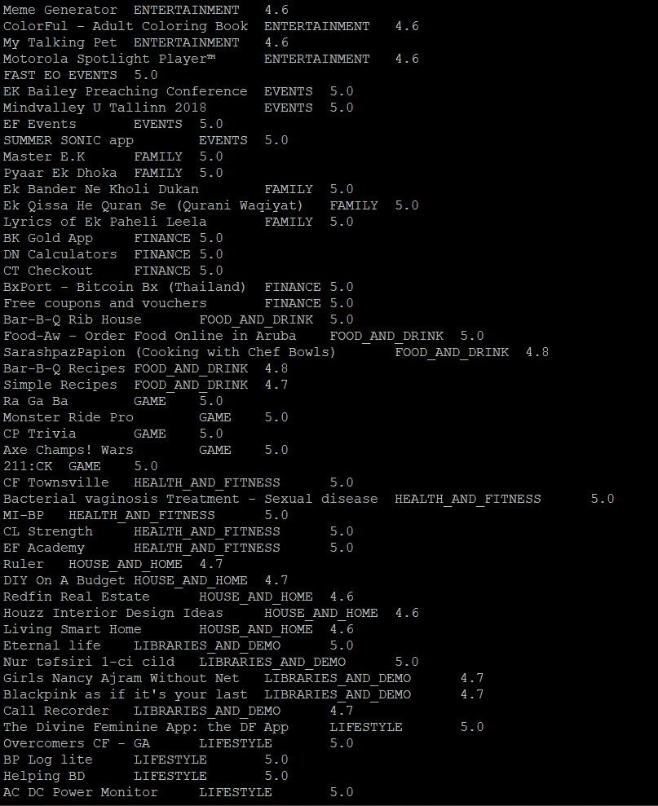
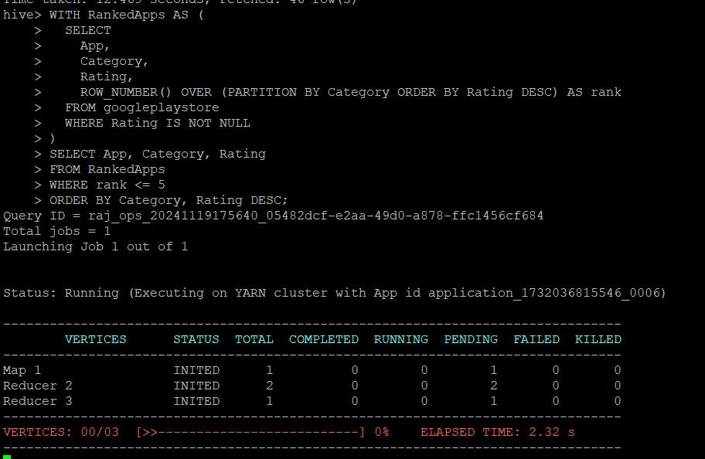
Play Store
Trends
Query 6
Find Top 5 Apps by Rating in Each Category:
WITH RankedApps AS (
SELECT
App,
Category,
Rating,
ROW_NUMBER() OVER (PARTITION BY Category ORDER BY Rating DESC) AS rank
FROM googleplaystore
WHERE Rating IS NOT NULL
)
SELECT App, Category, Rating
FROM RankedApps
WHERE rank <= 5
ORDER BY Category, Rating DESC;

Slide 11
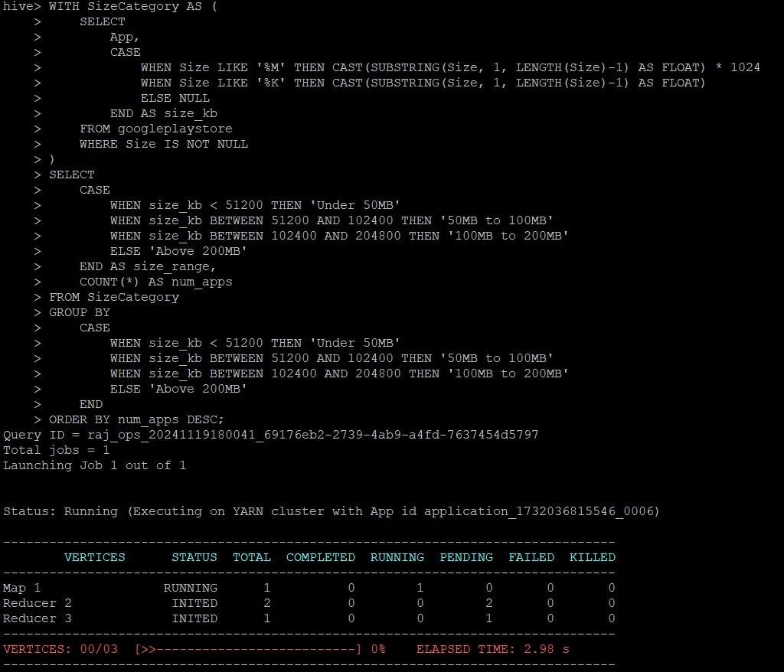
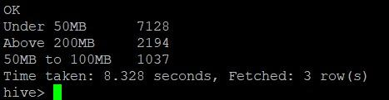
Play Store
Trends
Query 7
Find Apps with the Most Frequent Size Range (e.g., Apps under 50MB):
WITH SizeCategory AS (
SELECT
App,
CASE
WHEN Size LIKE '%M' THEN CAST(SUBSTRING(Size, 1, LENGTH(Size)-1) AS FLOAT) * 1024
WHEN Size LIKE '%K' THEN CAST(SUBSTRING(Size, 1, LENGTH(Size)-1) AS FLOAT)
ELSE NULL
END AS size_kb
FROM googleplaystore
WHERE Size IS NOT NULL
)
SELECT
CASE
WHEN size_kb < 51200 THEN 'Under 50MB'
WHEN size_kb BETWEEN 51200 AND 102400 THEN '50MB to 100MB'
WHEN size_kb BETWEEN 102400 AND 204800 THEN '100MB to 200MB'
ELSE 'Above 200MB'
END AS size_range,
COUNT(*) AS num_apps
FROM SizeCategory
GROUP BY
CASE
WHEN size_kb < 51200 THEN 'Under 50MB'
WHEN size_kb BETWEEN 51200 AND 102400 THEN '50MB to 100MB'
WHEN size_kb BETWEEN 102400 AND 204800 THEN '100MB to 200MB'
ELSE 'Above 200MB'
END
ORDER BY num_apps DESC;

Slide 12
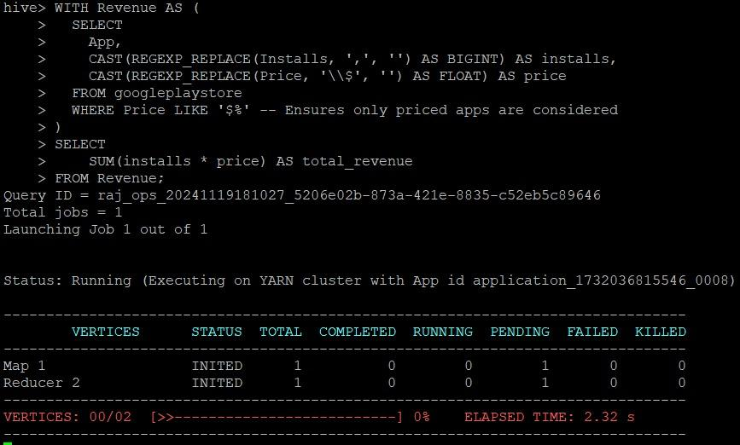
Play Store
Trends
Query 8
Calculate the Total Revenue for All Paid Apps:
WITH Revenue AS (
SELECT
App,
CAST(REGEXP_REPLACE(Installs, ',', '') AS BIGINT) AS installs,
CAST(REGEXP_REPLACE(Price, '\\$', '') AS FLOAT) AS price
FROM googleplaystore
WHERE Price LIKE '$%' -- Ensures only priced apps are considered
)
SELECT
SUM(installs * price) AS total_revenue
FROM Revenue;

Slide 13
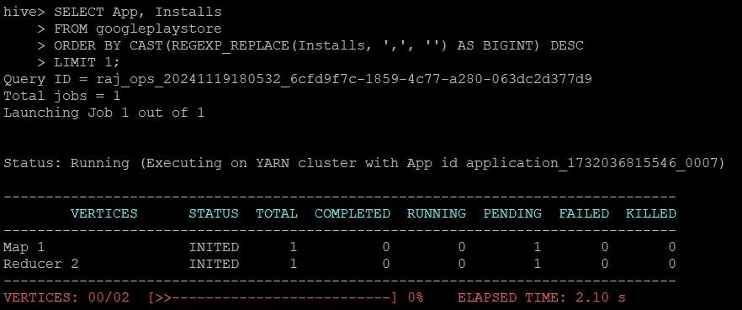
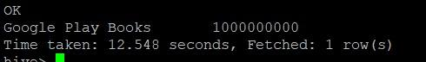
Play Store
Trends
Query 9
Find the Most Popular App in Terms of Installs :
SELECT App, Installs
FROM googleplaystore
ORDER BY CAST(REGEXP_REPLACE(Installs, ',', '') AS BIGINT) DESC
LIMIT 1;

Slide 14
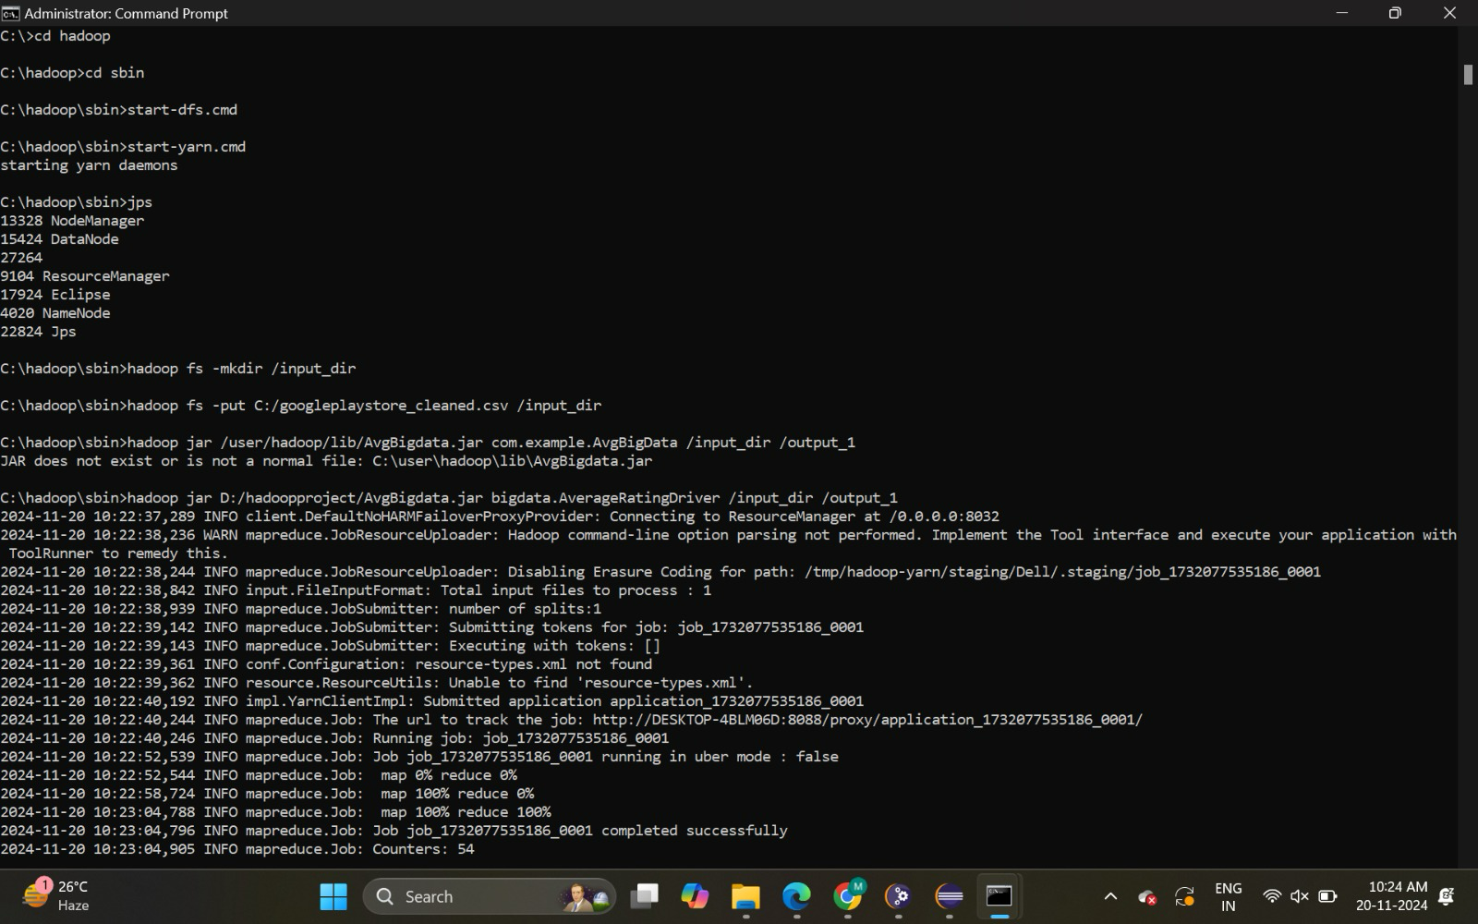
Play Store
Mapreduce
Trends

Slide 15
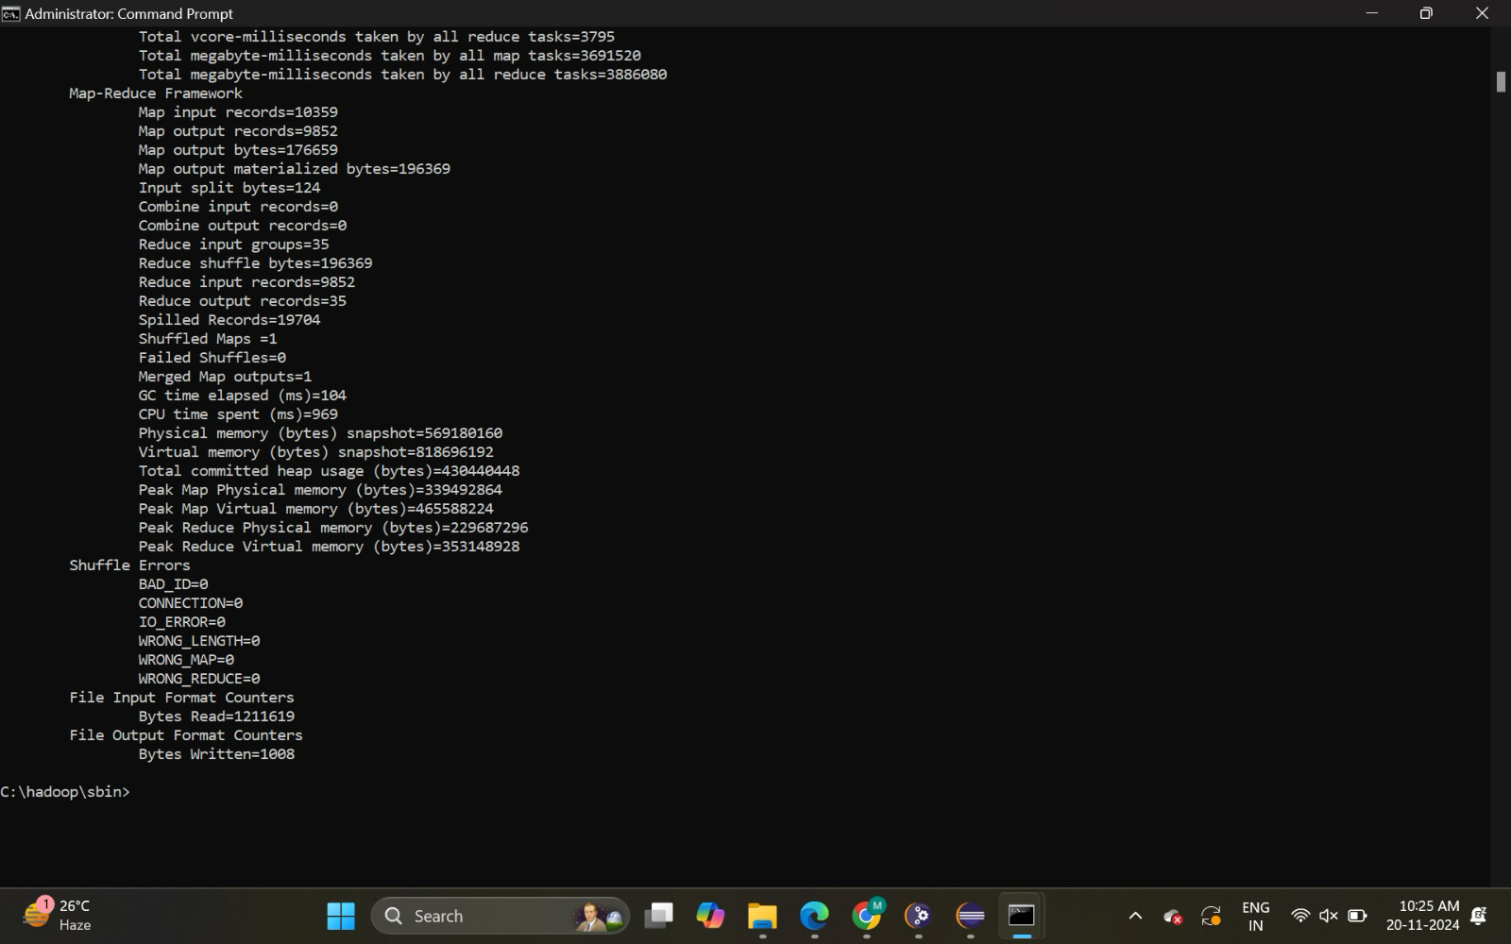
Play Store
Trends

Slide 16
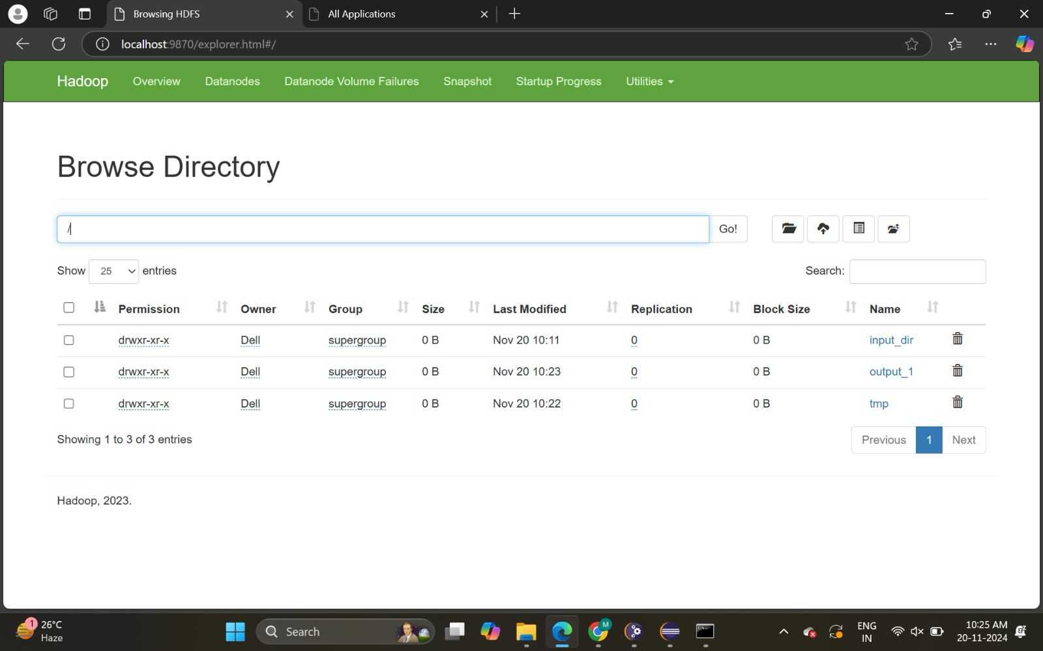
Play Store
Trends

Slide 17
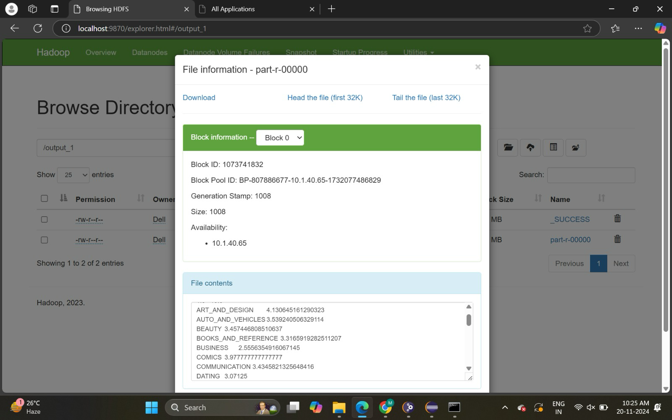
Play Store
Trends

Slide 18
TEAMMATES
Play Store
Hive
T . Dheeraj - AP21110010022
yes
no
G . Sricharan - AP21110010029
yes
no
M . Mounish - AP21110010031
yes
no
yes
no

Slide 19
Conclusion
Play Store
Trends
The project "Exploring Play Store Application Trends" sheds light on the dynamics of mobile app performance. Query 1, in particular, provides valuable insights into the ART_AND_DESIGN category, showing a preference for highly rated, free, and compact apps. These findings can guide developers in designing apps that align with market demands and user preferences.
By analyzing app trends, stakeholders can make data-driven decisions to optimize app offerings and enhance user experiences.

